Slide 1
SQL Core
2023

Slide 2
Chapter 1: Introduction to SQL
2023

Slide 3
Chapter 1: Introduction to SQL
Content:
Introduction to SQL
Introduction to RDMS

Slide 4
What is SQL?
Structured query language
Is a programming language for storing and processing information in a relational database. A relational database stores information in tabular form, with rows and columns representing different data attributes and the various relationships between the data values.
SQL (Structured Query Language) is a programming language designed to manage data stored in a relational database management system (RDBMS)

Slide 5
Introduction to RDBMS
RDBMS -- Relational Database Management system
RDBMS is the basis for all modern database systems such as
MySQL
Microsoft SQL Server
Oracle
Microsoft Access.
Characteristics of RDBMS:
Stores data in tabular form with rows and columns
Multiple tables can be accessed at the same time
Data is stored in tables related to one another
Notes:
The relational structure makes it possible to run queries across multiple tables at once.
MySQL
PostGreSQL
Oracle
For example a table containing employee data (names and addresses) may be related to a table containing payroll information (pay date pay amount and check number).

Slide 6
What is a Database
A collection of data.
It stores collection of tables related to one another.
It is a system that can be used for accessing and manipulating data.
Notes:
Database – a container that holds your tables and other sql structures related to those tables
This can be library data / hotel reservations / google searches / video game scores / bank accounts…

Slide 7
Table
Is the structure inside your database that contains data organized in columns and rows
In Excel
In SQL
Column 1 | Column 2 | Column 3 | Column 4
Row 1
Row 2
Field 1 | Field 2 | Field 3 | Field 4
Record 1
Record 2
Notes:
A table stores data in a structured file on a server s hard drive.
Each file joins data together using relationships. → links that join tables together using related information.
SQL would then link the two relational tables together.
As you add more data your design matters more.
A poor design affects accuracy and performance.

Slide 8
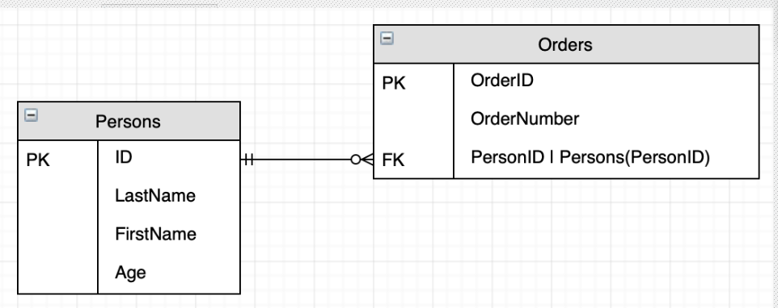
Database terminology
Primary Key - unique and mandatory identifier
Foreign Key - A cross-reference between tables because it references the primary key of another table.
Relationship - created though foreign keys
Data types – Specifies the type of data entered in a field
Notes:
A record is also called as a row of data is each individual entry that exists in a table. For example there are 7 records in the above CUSTOMERS table.
What is a field - Every table is broken up into smaller entities called fields. The fields in the CUSTOMERS table consist of ID NAME AGE ADDRESS and SALARY. A field is a column in a table that is designed to maintain specific information about every record in the table.
Data types – Char text integer date…
SQL constraints – not null / unique / primary key / foreign key…

Slide 9
Why SQL
SQL is effective at data manipulation.
Data testing and manipulating is faster on SQL.
Large amount of data is retrieved quickly and efficiently
Data retrieval is easier, large number of lines of code is not required. All basic keywords such as SELECT, INSERT INTO, UPDATE, etc. are used and the syntactical rules are not complex in SQL, which makes it very user-friendly language.
It is a standardized Language, it provides a uniform platform worldwide to all its users.
Easy to learn and understand, answers to complex queries can be received in seconds.
SQL can handle large volumes of data.

Slide 10
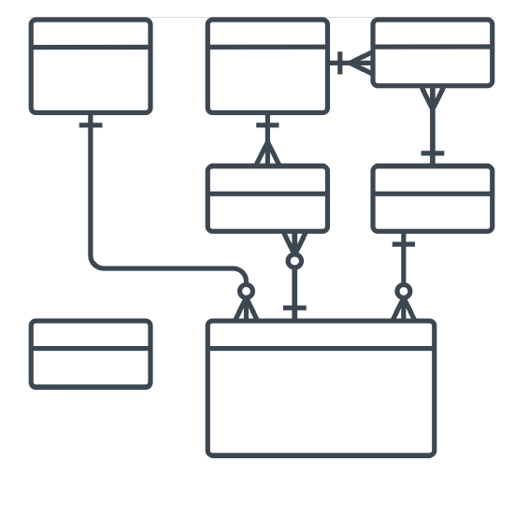
What is a schema (Database)
a logical collection of database objects
A representation of all the structures such as tables columns and relationships in your database is called a schema
Notes:
Tables / Fields / views / relationships / functions / types / packages / procedures / directories
http://webdev.slides.com/coltsteele/mysql-106 (Instagram schema)

Slide 11
types of SQL statements
SQL | DML DDL DCL
SQL Comprises of 3 major sub-languages:
DML – Data Manipulation Language
DDL – Data Definition Language
DCL – Data Control Language
Notes:
DDL – Data Definition Language (Create / modify the structure of the database - Create / Alter / Drop)
DML – Data Manipulation Language (/ Insert / Update / Delete)
DCL – Data Control Language (To control the access of the data stored in the database - Grant / Revoke)
DQL – Data Query Language

Slide 12
DML(Data Manipulation Language)
The SQL commands that deals with the manipulation of data present in the database belong to DML or Data Manipulation Language and this includes most of the SQL statements.
DML statements are used to view, add, modify or delete stored data in your database objects
Examples of DML:
SELECT – is used to view data from existing tables
INSERT – is used to insert data into a table.
UPDATE – is used to update existing data within a table.
DELETE – is used to delete records from a database table.
Notes:
The core DML operations → CRUD (Create / Read / Update / Delete) which are perform using the statements Insert select Update and Delete
Retrieve insert update and delete data in tables. Define transactions. Define and delete views. Execute stored SQL procedures. Execute triggers.

Slide 13
DDL (Data Definition Language) commands:
DDL actually consists of the SQL commands that can be used to define the database schema.
DDL statements are used to create, modify or delete database objects such as tables, views, schemas, domains, triggers and stored procedures
Create
Drop
Alter
Truncate
Notes:
DDL or Data Definition Language actually consists of the SQL commands that can be used to define the database schema.
It simply deals with descriptions of the database schema and is used to create and modify the structure of database objects in the database.
Examples of DDL commands:
CREATE – is used to create the database or its objects (like table index function views store procedure and triggers).
DROP – is used to delete objects from the database.
ALTER-is used to alter the structure of the database.
TRUNCATE–is used to remove all records from a table including all spaces allocated for the records are removed.
COMMENT –is used to add comments to the data dictionary.
RENAME –is used to rename an object existing in the database.
Create modify and delete tables. Create and delete views. Create and delete indexes. Create and delete stored SQL procedures. Create and delete triggers. Create and delete user-defined functions.

Slide 14
DCL(Data Control Language)
DCL includes commands such as GRANT and REVOKE which mainly deals with the rights permissions and other controls of the database system.
DCL statements allow you to control who has access to specific objects in your database. You would also be able to control which users can view a specific set of data, and which users can manipulate that data
Examples of DCL commands:
GRANT-gives users access privileges to database.
REVOKE-withdraw user s access privileges given by using the GRANT command
Notes:
Enable and disable security for a dictionary. Create and delete users. Add and drop users from groups. Change user passwords. Grant and revoke table access rights.

Slide 15
Cases used to name DB objects
Two common ways of formatting table / Column names
CamelCase
snake_case
Notes:
Select FirstName LastName from Employees
Select first_name last_name from employees
*Keywords are not case sensitive however it is common practice to write them in upper case
*Indenting – No widely accepted std just don t squeeze it all on 1 line

Slide 16
comment out section
MySQL
# This comment continues to the end of line
-- This comment continues to the end of line (double-dash-space)
/* this is an in-line comment */
/* this is a multiple-line
comment */
SQL Server
-- This comment continues to the end of line (no space needed at the end)
Notes:
In MySQL the ”-- ”(double-dash) comment style requires the second dash to be followed by at least one white space
# This comment continues to the end of line
-- This comment continues to the end of line
/* this is an in-line comment */
/* this is a multiple-line
comment */
SQL Server
-- This comment continues to the end of line
Single line comments:
--this is a comment
Multi-Line comments
/* this is a comment that runs
over 2 lines*/

Slide 17
Commenting
Single Line Comments
Single line comments start with --.
Any text between -- and the end of the line will be ignored (will not be executed).
Multi-line Comments
Multi-line comments start with /* and end with */.
Any text between /* and */ will be ignored.
--Select all: SELECT * FROM Customers;
SELECT * FROM Customers -- WHERE City= Berlin ;
/*Select all the columns of all the records in the Customers table:*/ SELECT * FROM Customers;
Notes:
SQL Comments
Comments are used to explain sections of SQL statements or to prevent execution of SQL statements.
Single-Line Comments: These start with “–”. Any text that goes after the dash and till the end of the line will not be taken into account by the compiler.
Multi-Line Comments: These start with /* and end with */. Again any text that is beyond the slashes lines will be ignored by the compiler.

Slide 18
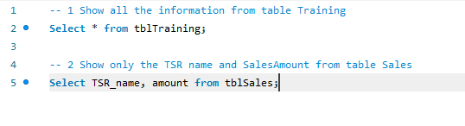
Commenting
Once we start working in MySQL workbench or SQL Server Management studio, we’ll use comments to indicate the question numbers that we’ll be working with:

